Slide 1
E-Commerce Store – Exploratory Data Analysis
Homework 1 · Jakub Wojciechowski · Kozminski University

Slide 2
Dataset overview
698
10
0
0
rows (sales records)
columns (variables)
missing values
duplicate rows
Categorical variables (4) + Date
Region
Brand
Product
Product Type
Date (date variable)
Numerical variables (5)
Sales
Profit
Units Sold
Discount (%)
Customer Rating
The data is clean and covers the whole year 2023 (1 Jan – 31 Dec). Date was converted from text to a date.

Slide 3
Descriptive statistics
Variable | Mean | Std | Min | Median | Max | Skewness
Sales | 7,358.32 | 3,094.97 | 1,254.22 | 7,355.24 | 13,641.03 | -0.025
Profit | 2,488.09 | 1,004.72 | 401.08 | 2,458.86 | 4,455.56 | -0.006
Units Sold | 226.72 | 98.30 | 50.00 | 225.00 | 399.00 | -0.016
Discount (%) | 12.76 | 6.82 | 1.01 | 12.91 | 24.89 | 0.034
Customer Rating | 3.66 | 0.65 | 1.86 | 3.65 | 5.00 | -0.100
Average sale is 7,358 and average profit is 2,488. On average 227 units are sold, with a 12.8% discount and a 3.66 rating.
Skewness is close to 0 for all variables, so the distributions are symmetric.

Slide 4
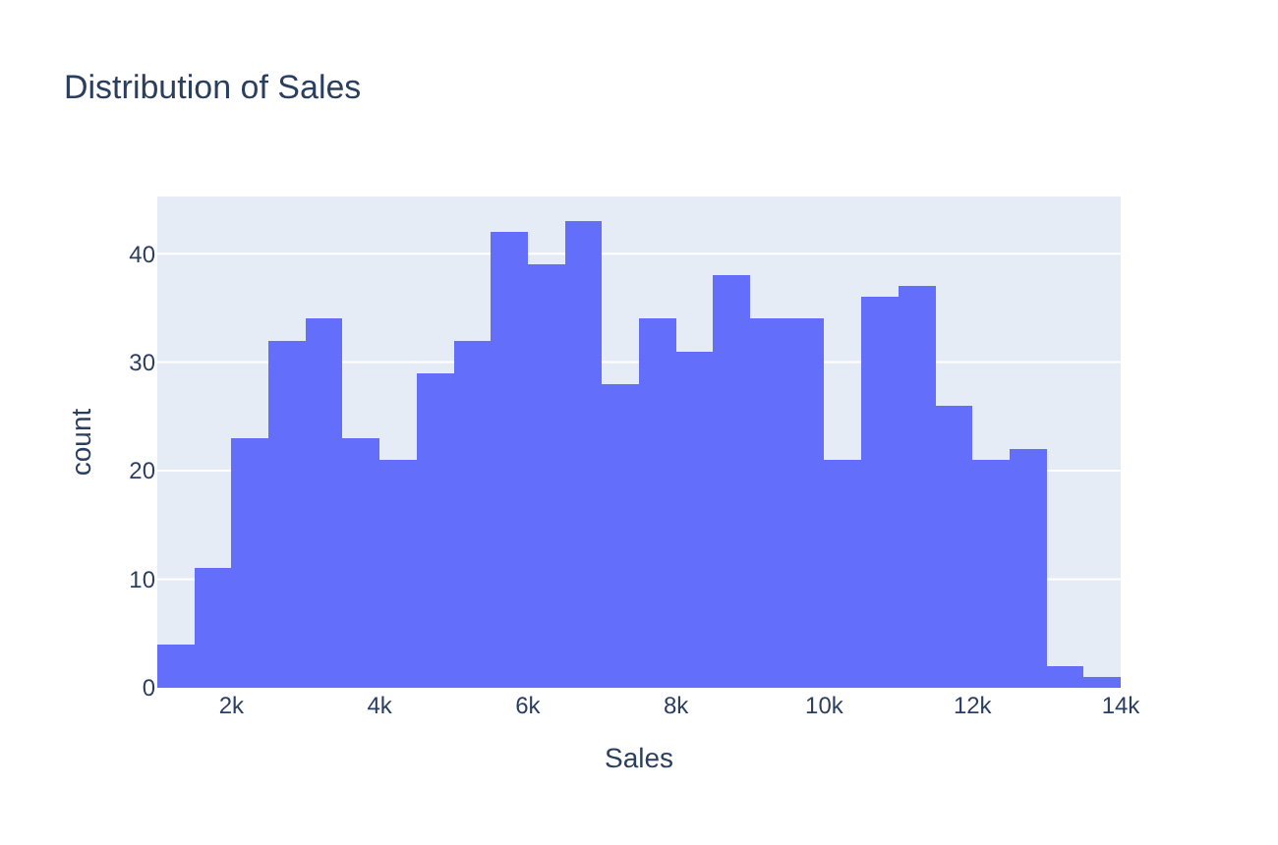
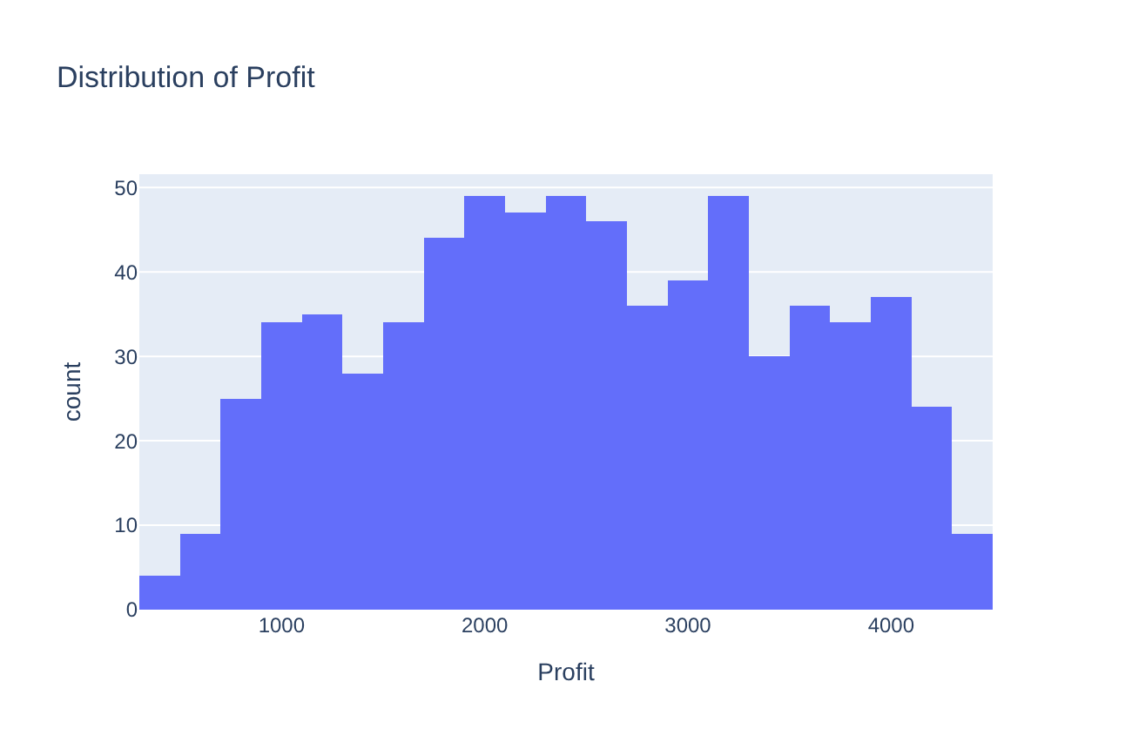
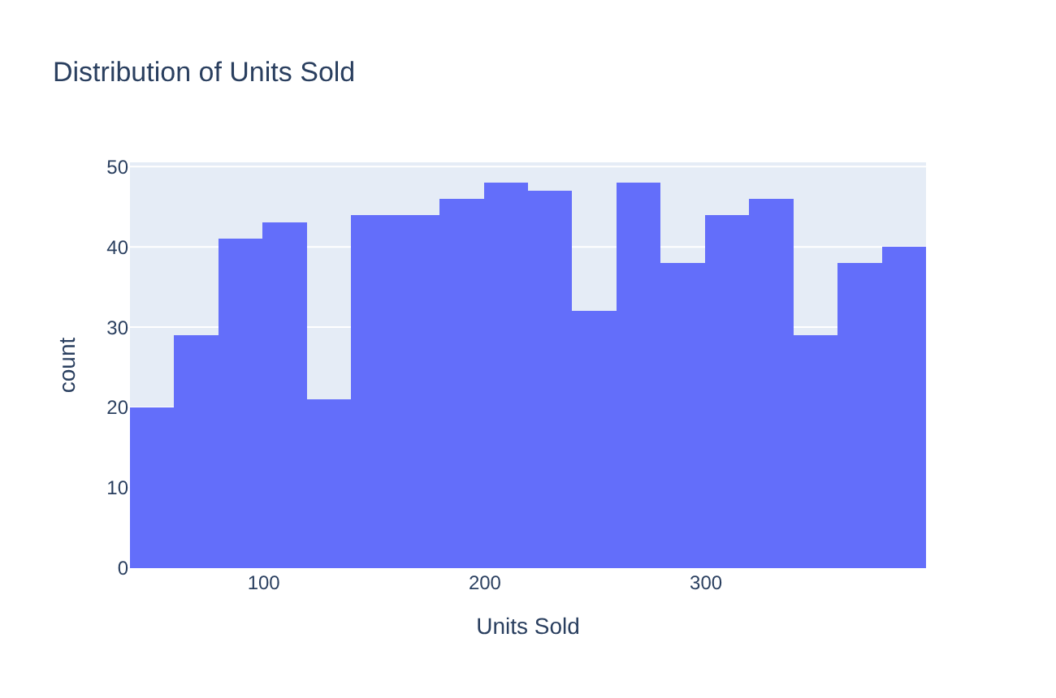
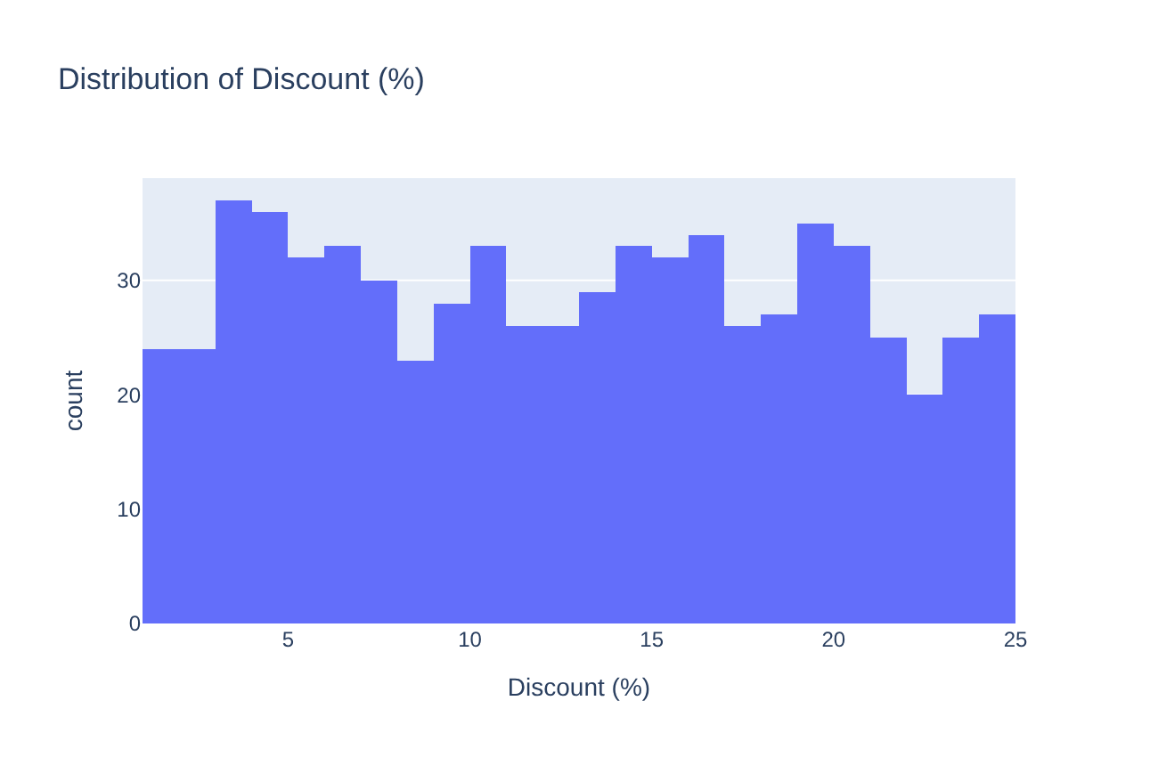
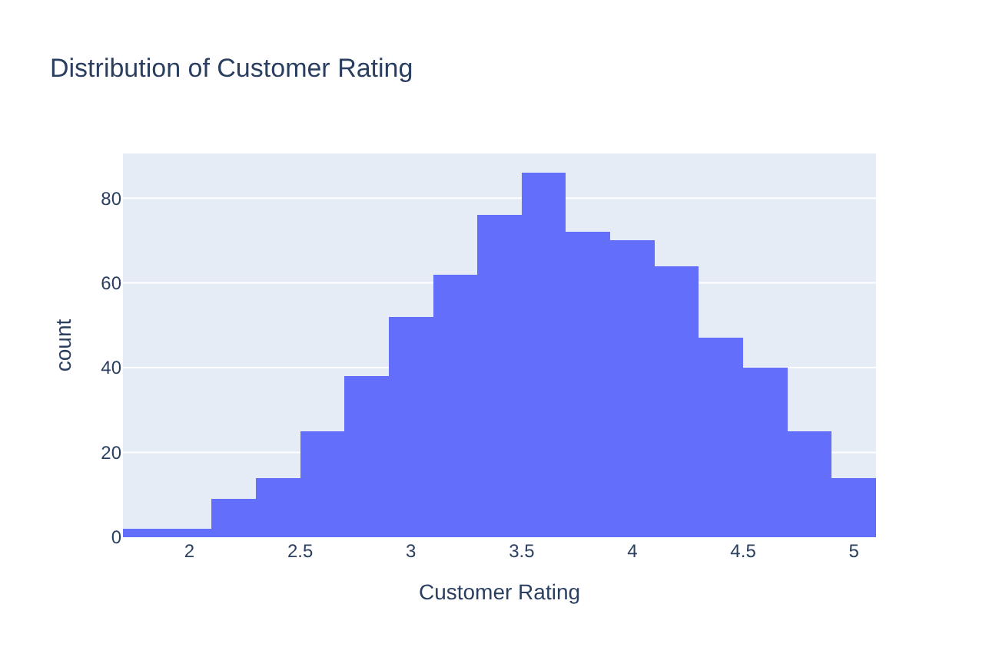
Distribution of numerical variables
Sales, Profit, Units Sold and Discount are spread widely over their range, without one clear peak.
Customer Rating has a bell shape with most values around 3.5–4.

Slide 5
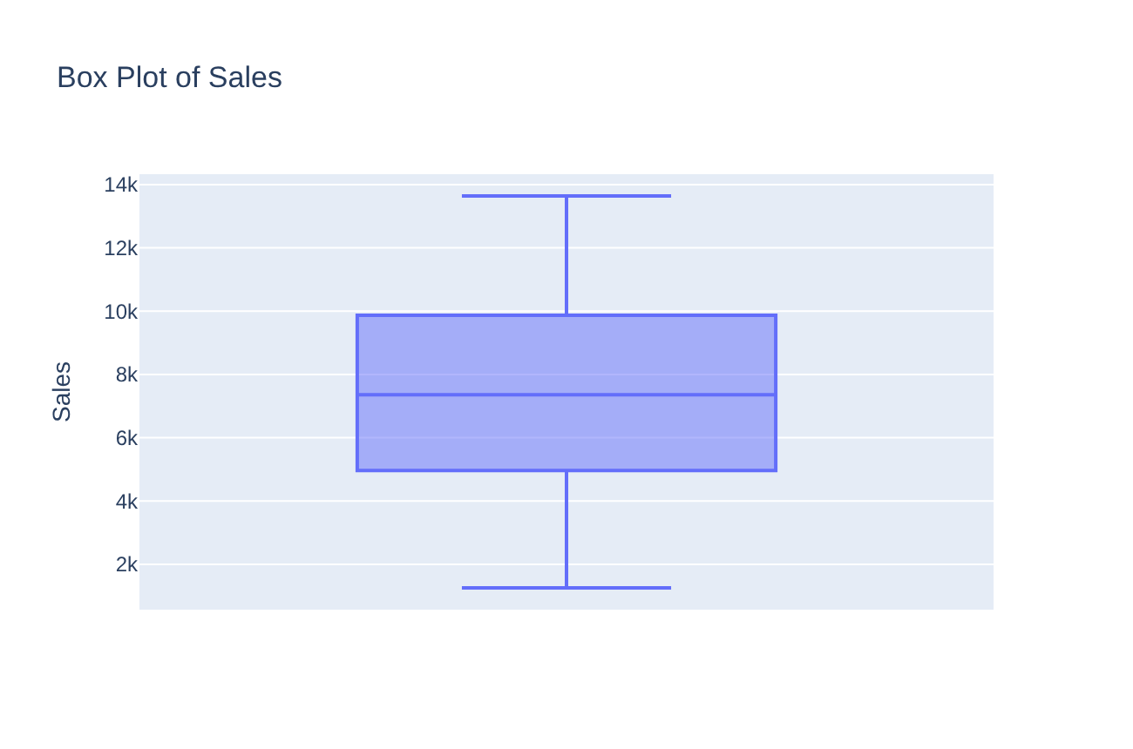
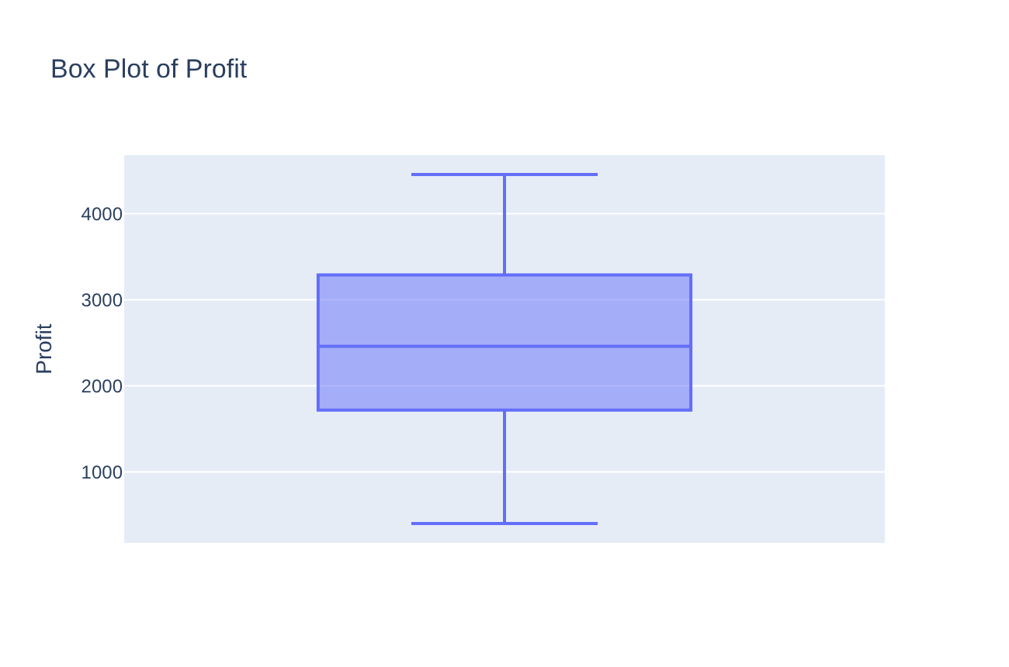
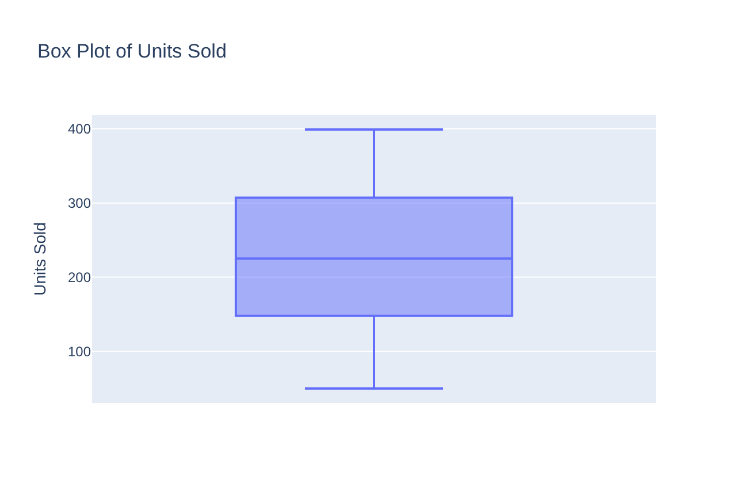
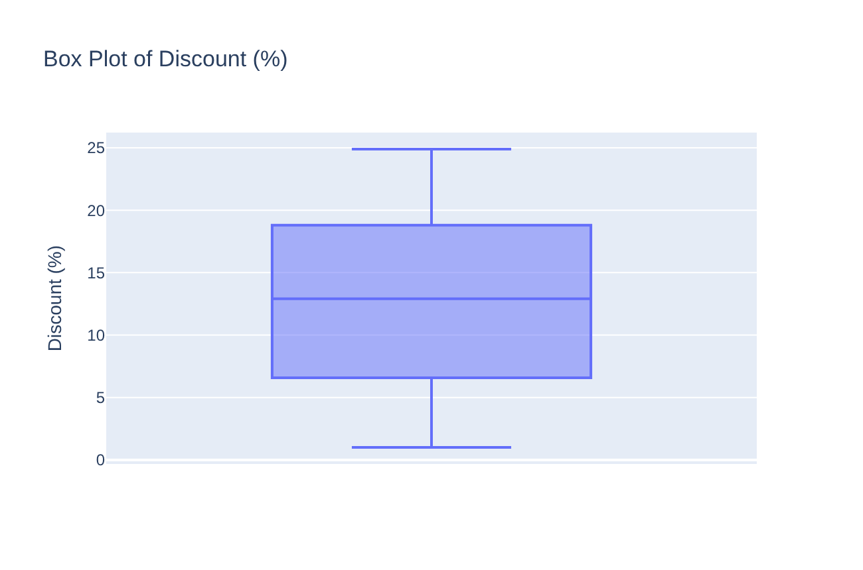
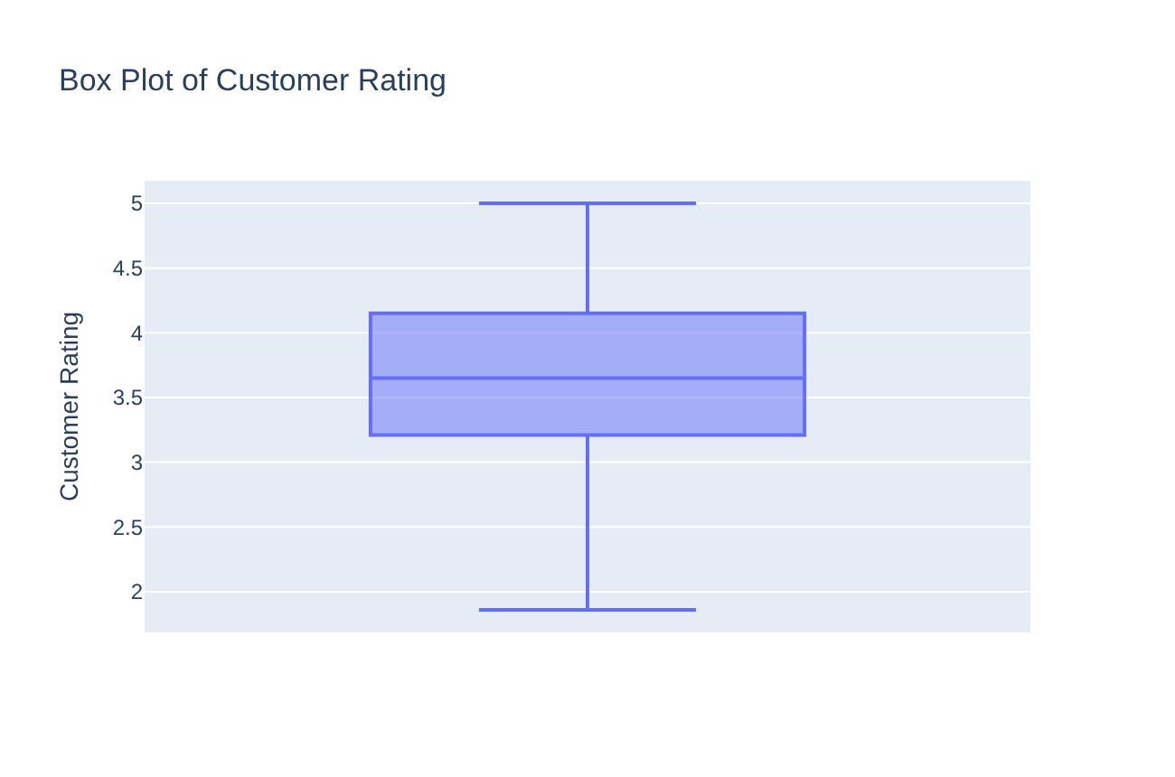
Box plots – no outliers
All values are inside the whiskers – there are no outliers in any numerical variable.

Slide 6
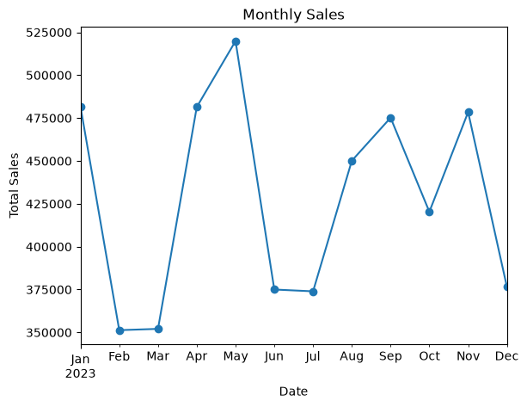
Monthly sales in 2023
Total sales change from month to month.
Highest month: May.
Lowest months: February and March.
There is no clear trend over the year.

Slide 7
Categorical variables – frequencies and percentages
Region | Count | %
West | 187 | 26.8
East | 184 | 26.4
South | 174 | 24.9
North | 153 | 21.9
Brand | Count | %
Brand A | 184 | 26.4
Brand C | 180 | 25.8
Brand B | 173 | 24.8
Brand D | 161 | 23.1
Product | Count | %
Product 2 | 173 | 24.8
Product 1 | 140 | 20.1
Product 5 | 133 | 19.1
Product 3 | 126 | 18.1
Product 4 | 126 | 18.1
Product Type | Count | %
Consumer Goods | 179 | 25.6
Electronics | 178 | 25.5
Apparel | 176 | 25.2
Home Appliances | 165 | 23.6
All categories have a similar share of records (about 18–27% each).
Region: West and East have the most records, North the fewest (21.9%).
Product 2 is the most common product (24.8%). Product types are almost equal (23.6–25.6%).

Slide 8
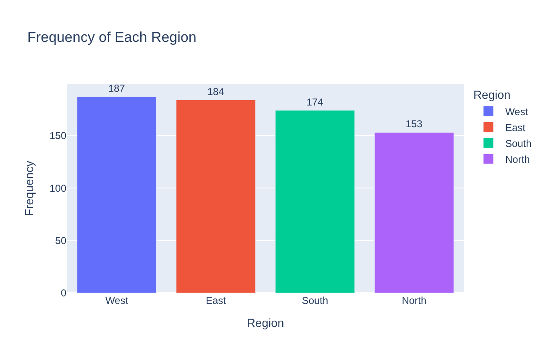
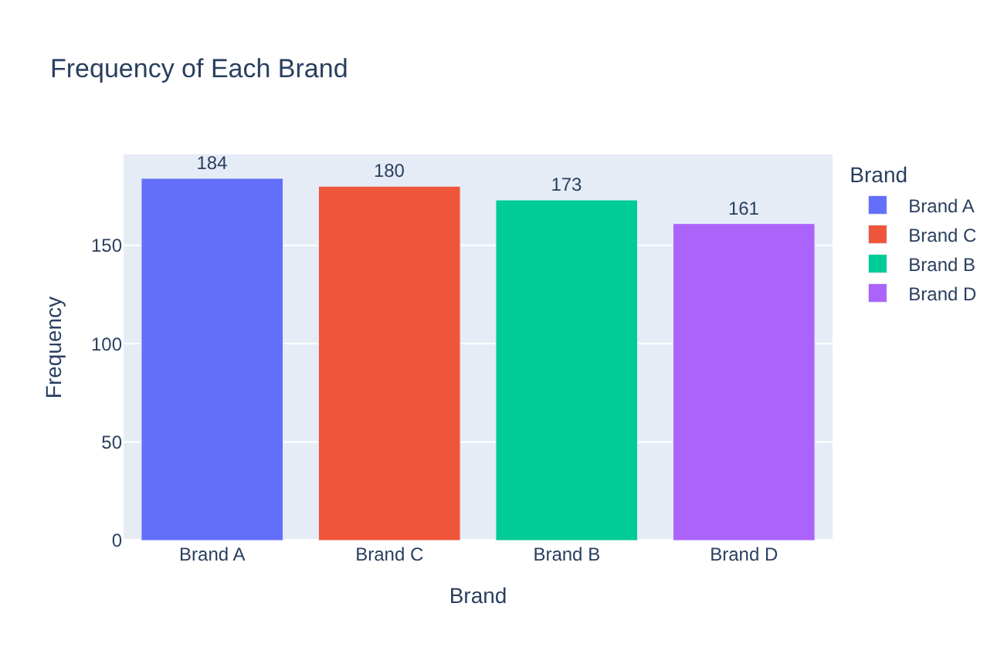
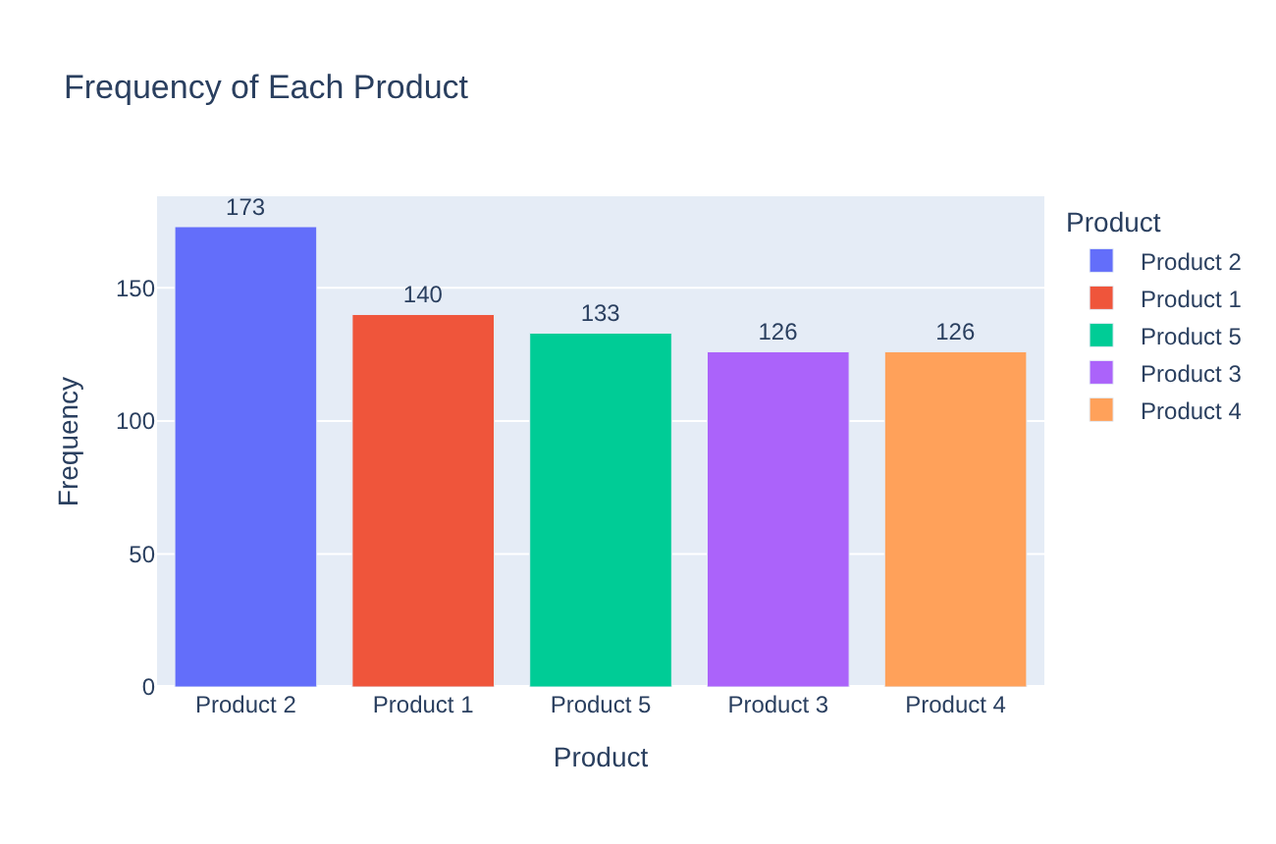
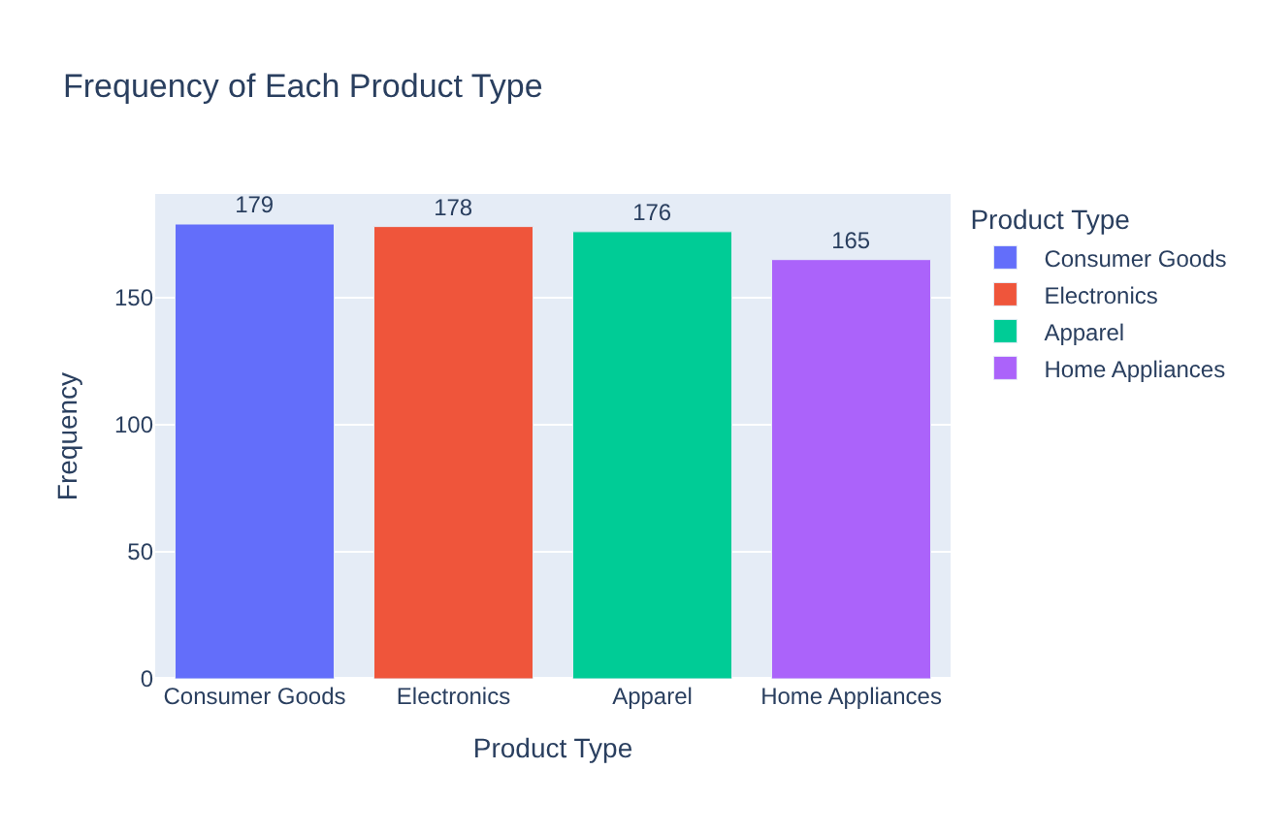
Categorical variables – bar charts

Slide 9
Product type mix by region
Region (row = 100%) | Apparel | Consumer Goods | Electronics | Home Appliances
East | 28.8% | 23.9% | 20.1% | 27.2%
North | 24.2% | 29.4% | 22.9% | 23.5%
South | 27.0% | 25.3% | 27.0% | 20.7%
West | 20.9% | 24.6% | 31.6% | 23.0%
Chi-square test
χ² = 10.7846, df = 9, p-value = 0.2908
p > 0.05: the product type mix does not depend on the region.
There are some differences, e.g. Electronics is 31.6% of records in West but 20.1% in East – but the test shows they are not significant.

Slide 10
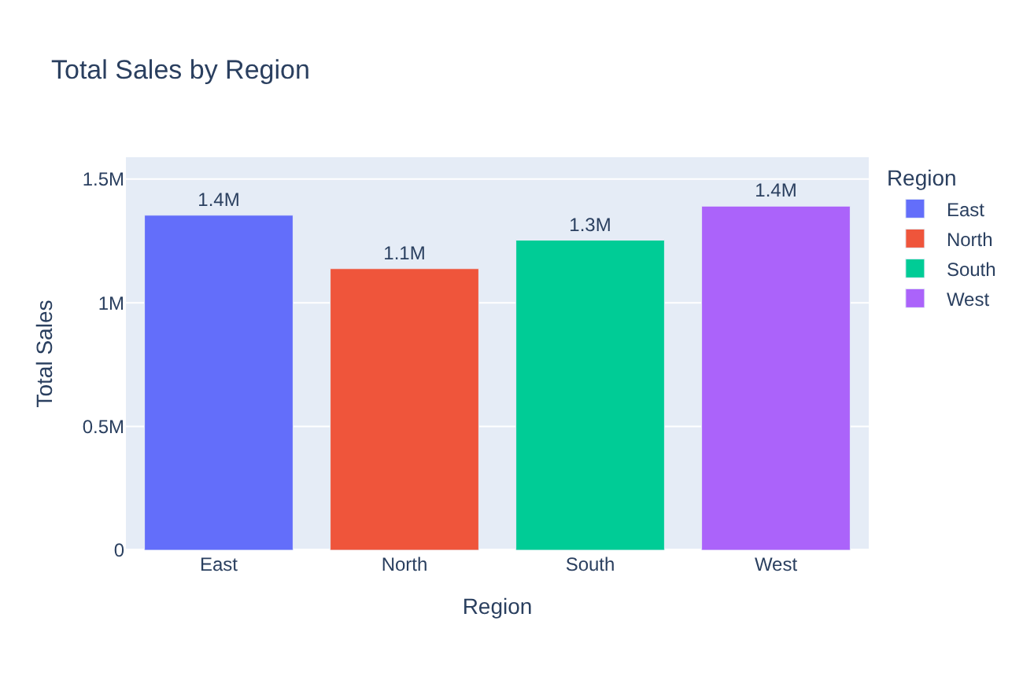
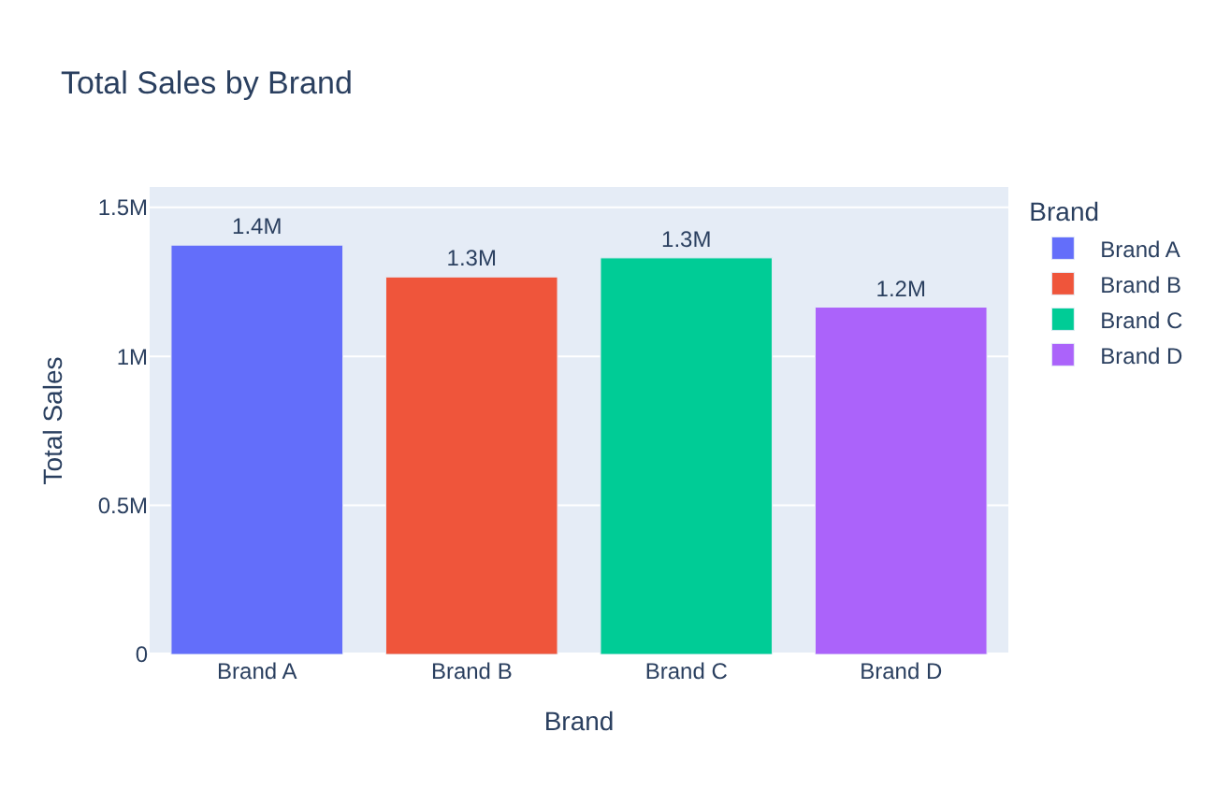
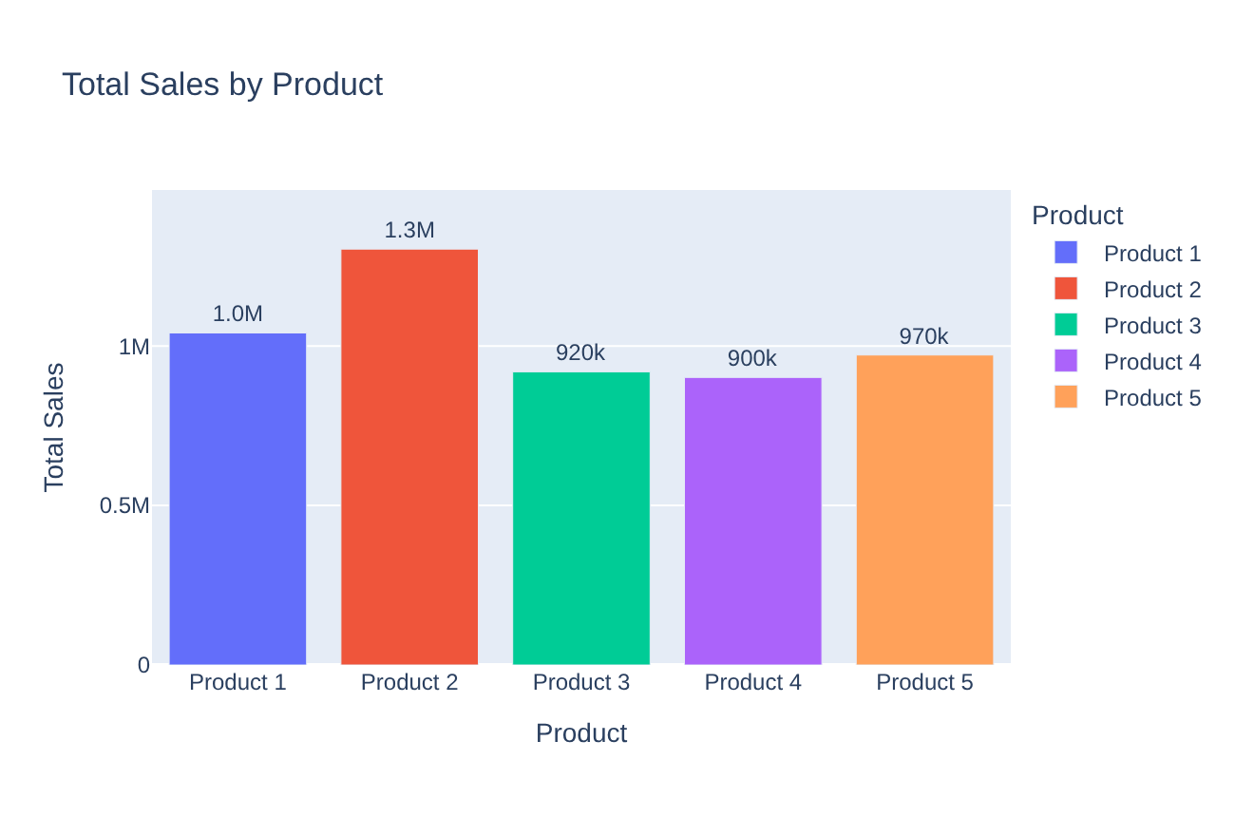
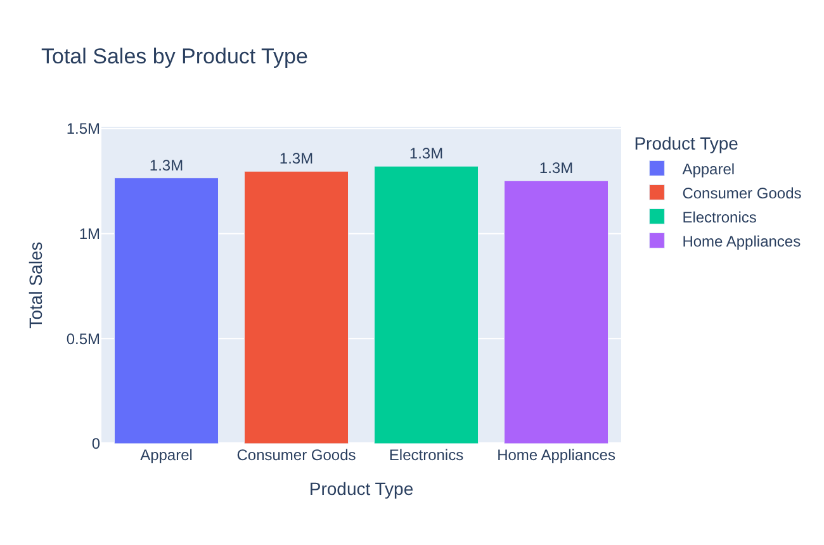
Total sales by group
West and East have the highest sales, North the lowest.
Brand A and Product 2 are the best.
Product types are almost equal.
Totals mostly follow the number of records in each group.

Slide 11
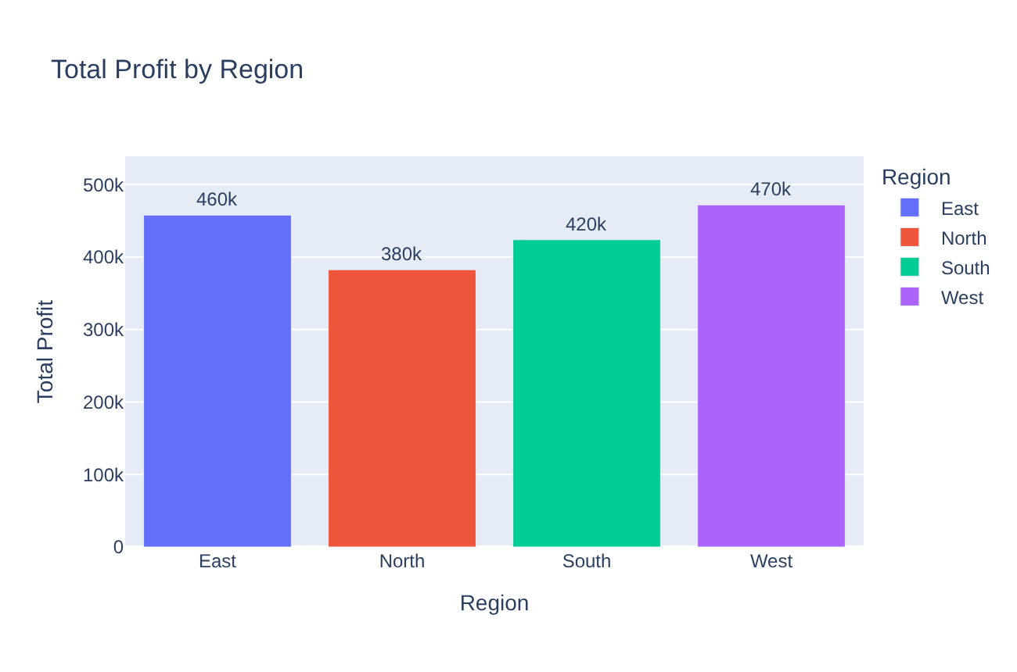

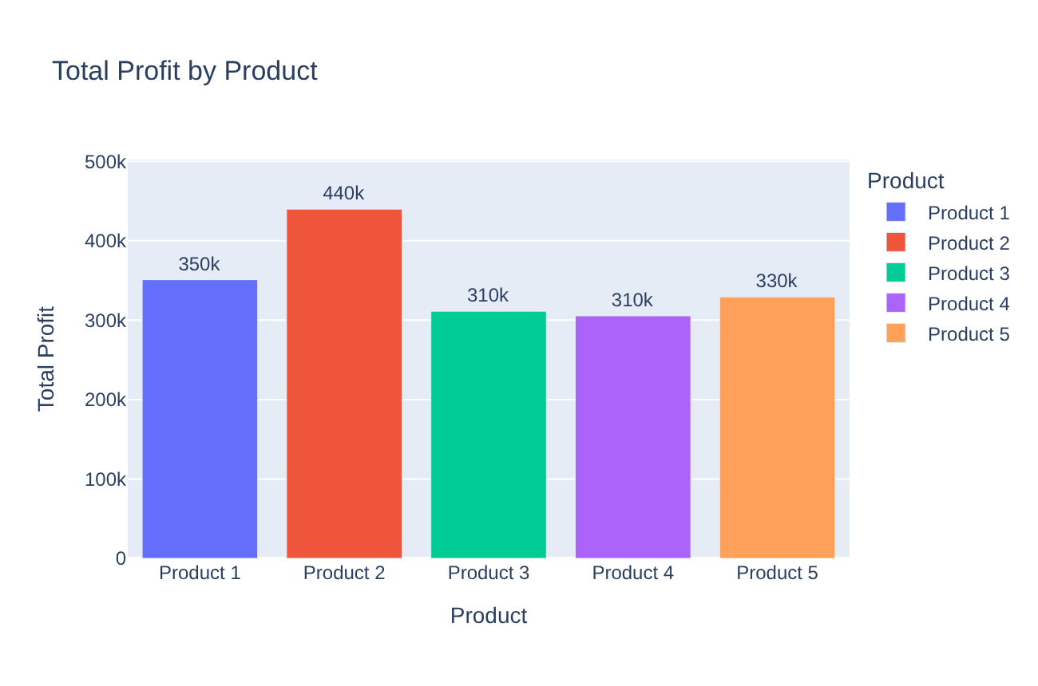
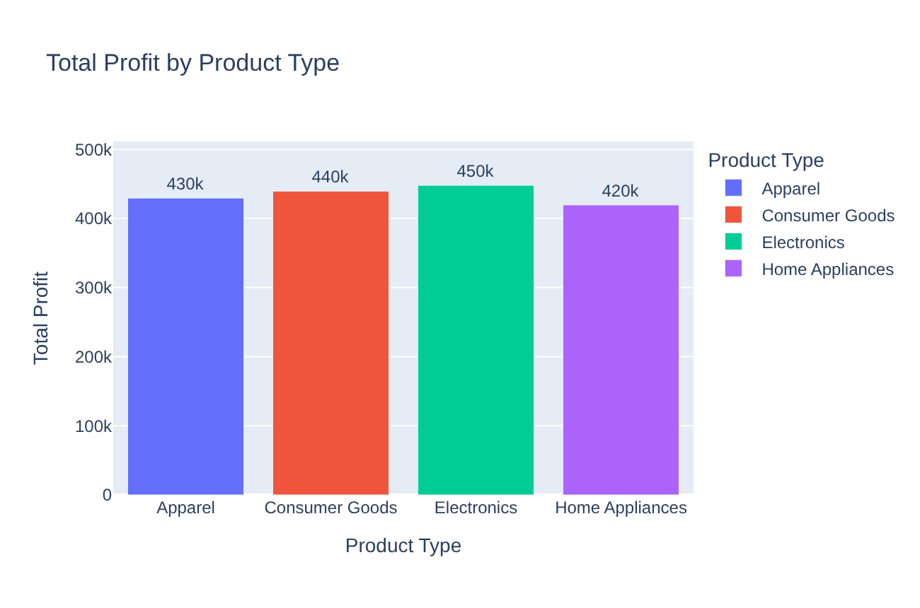
Total profit by group
Total profit shows the same ranking as total sales.
West, Brand A and Product 2 have the highest total profit.
Again, groups with more records usually have higher totals.

Slide 12
Average sales, profit and margin by group
Group | Category | Avg Sales | Avg Profit | Margin (%)
Region | East | 7,358.87 | 2,489.04 | 34.22
 | North | 7,438.54 | 2,500.83 | 34.03
 | South | 7,202.25 | 2,436.89 | 34.41
 | West | 7,437.37 | 2,524.39 | 34.61
Brand | Brand A | 7,464.44 | 2,537.45 | 34.77
 | Brand B | 7,321.70 | 2,448.89 | 33.75
 | Brand C | 7,392.11 | 2,501.89 | 34.39
 | Brand D | 7,238.61 | 2,458.38 | 34.39
Product | Product 1 | 7,433.74 | 2,506.63 | 34.30
 | Product 2 | 7,535.33 | 2,542.06 | 34.20
 | Product 3 | 7,293.27 | 2,470.37 | 34.45
 | Product 4 | 7,152.74 | 2,423.84 | 34.40
 | Product 5 | 7,305.07 | 2,476.05 | 34.36
Product Type | Apparel | 7,191.48 | 2,440.72 | 34.63
 | Consumer Goods | 7,246.71 | 2,455.62 | 34.34
 | Electronics | 7,423.72 | 2,516.57 | 34.40
 | Home Appliances | 7,586.81 | 2,543.13 | 33.94
Average profit is very similar in all groups (2,424–2,543).
Profit margin is about 34% everywhere (33.75–34.77%).
Home Appliances has the lowest total profit but the highest average profit (2,543) – it just has fewer records.
No group is more profitable per sale.

Slide 13
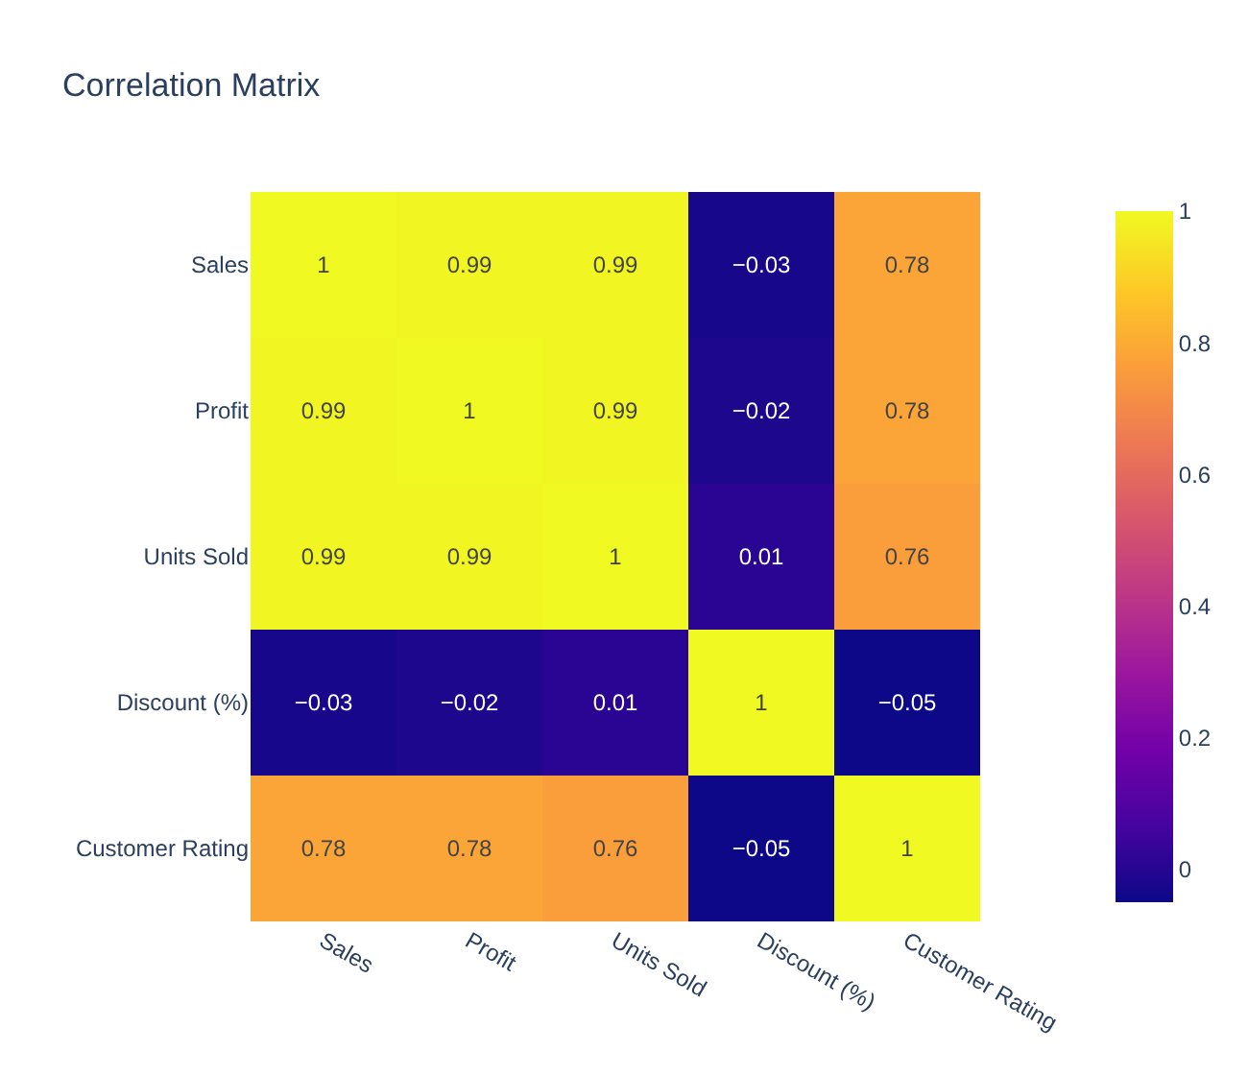
Correlation between numerical variables
Sales, Profit and Units Sold are almost perfectly correlated (0.99).
Customer Rating has a strong positive correlation with them (0.76–0.78).
Discount has almost no correlation with anything (−0.05 to 0.01).

Slide 14
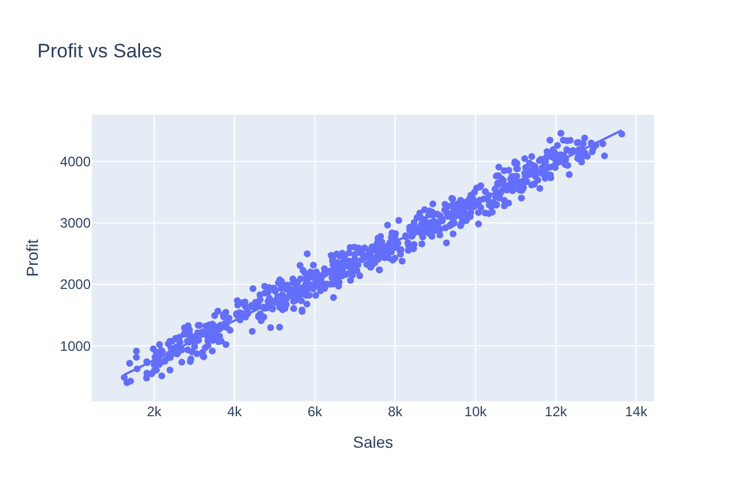
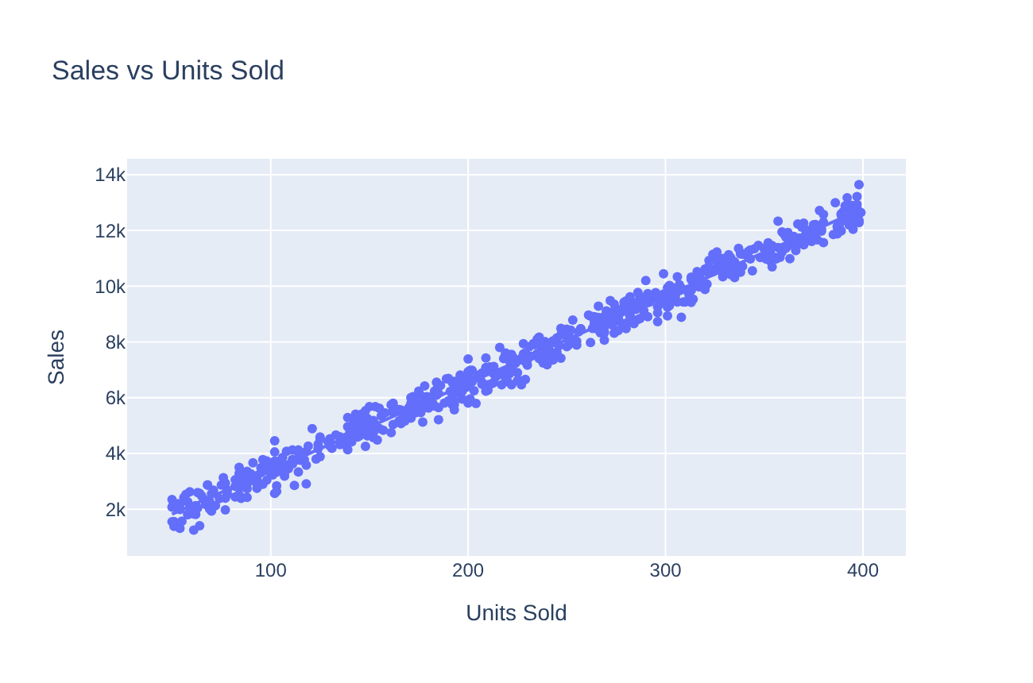
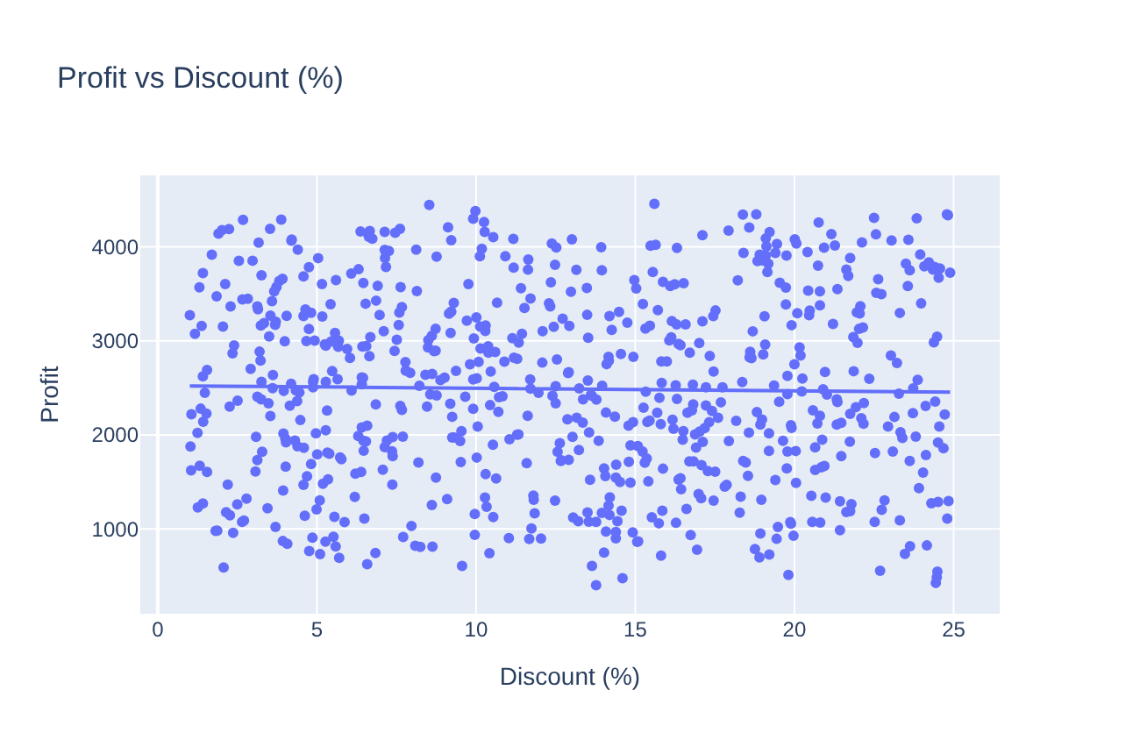
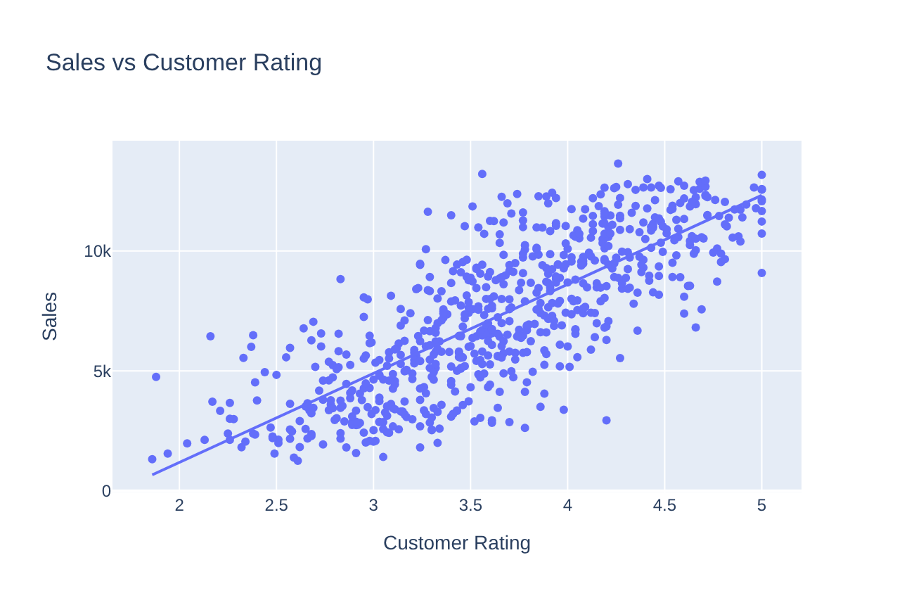
Relationships – scatter plots
Profit grows with Sales, and Sales grow with Units Sold, in an almost straight line.
Higher ratings come with higher sales.
The Discount line is flat – a bigger discount does not change profit.

Slide 15
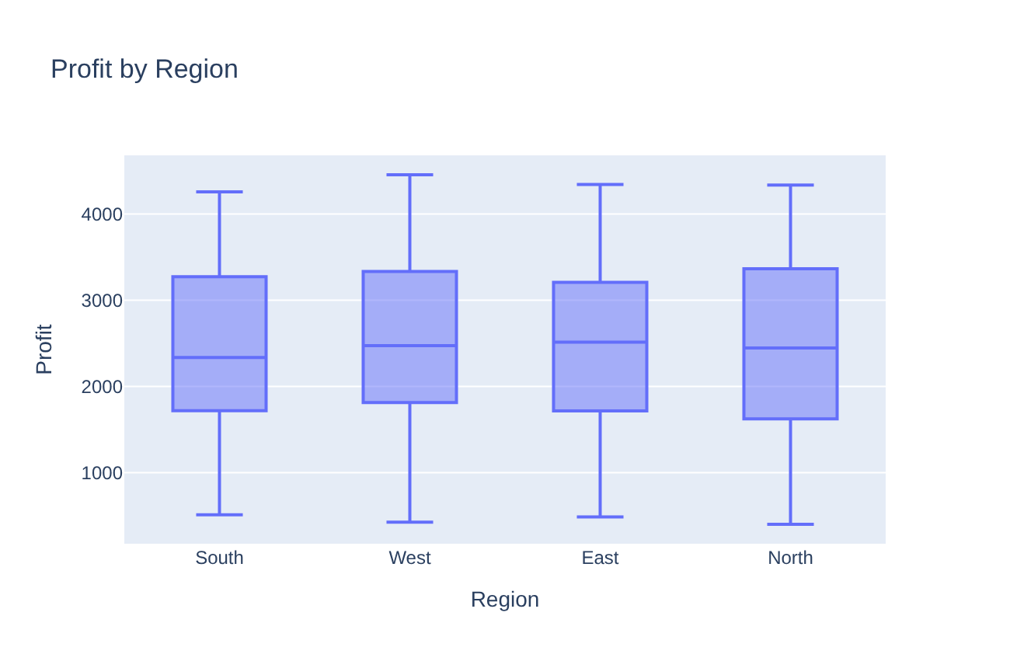
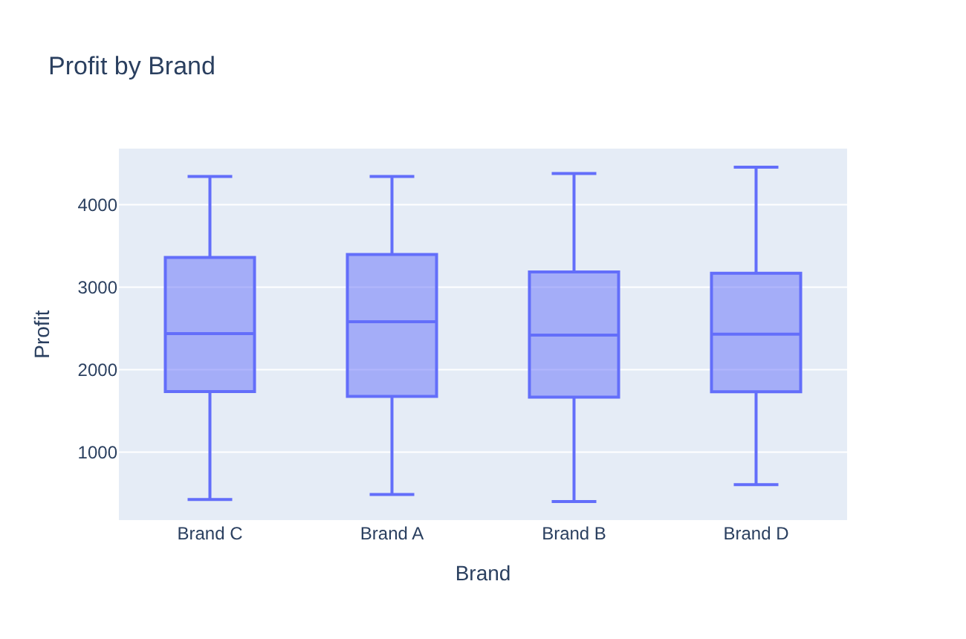
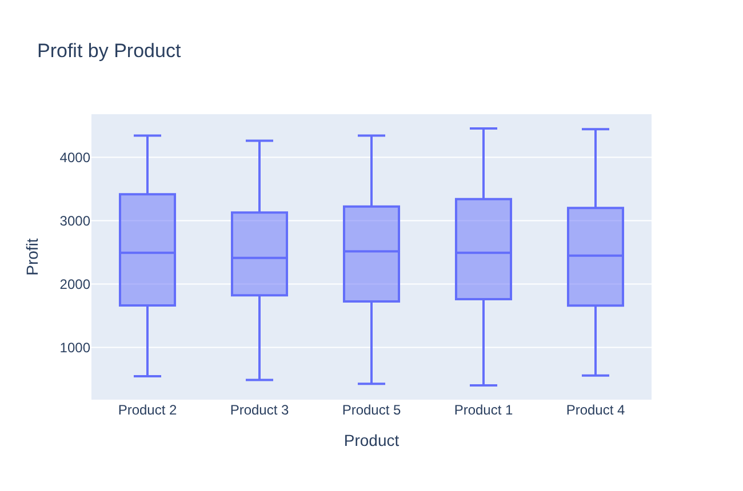
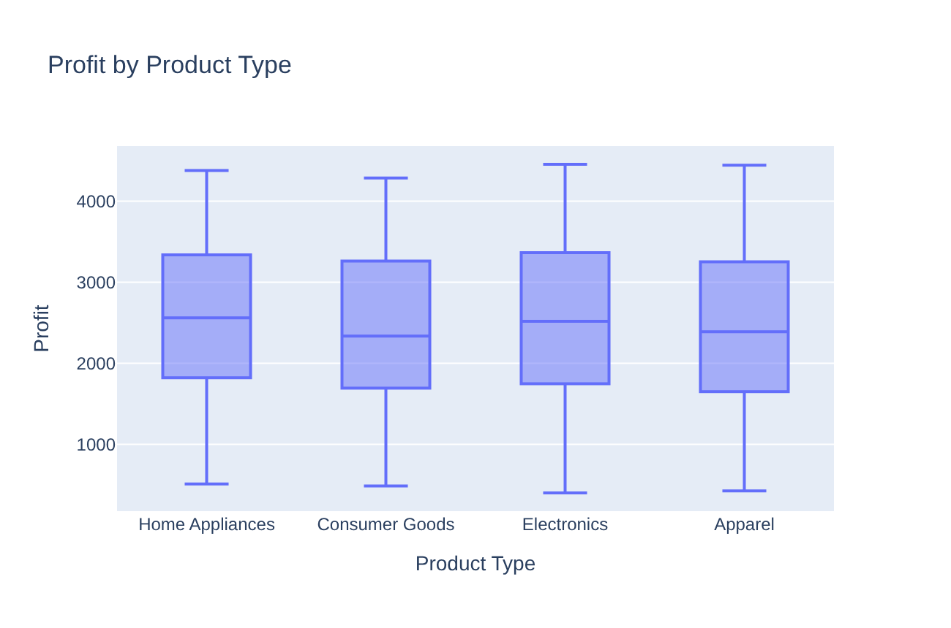
Profit by category – box plots and ANOVA
Variable | F | p-value
Region | 0.239 | 0.869
Brand | 0.293 | 0.830
Product | 0.279 | 0.892
Product Type | 0.404 | 0.750
The box plots look almost the same in all groups.
ANOVA: all p-values > 0.05, so average profit does not differ significantly between groups.

Slide 16
Overall findings
Clean data
698 records, 10 variables, no missing values, no duplicates, no outliers, the whole year 2023.
Balanced categories
Regions, brands, products and product types have a similar number of records.
Distributions
Sales, Profit, Units Sold and Discount are spread widely. Customer Rating is bell-shaped around 3.5–4.
Volume drives profit
Sales, Profit and Units Sold are almost perfectly correlated (0.99). Margin is about 34% in every group.
Rating matters
Higher customer ratings come with higher sales (correlation 0.78).
Discount does not help
Discount has no link with sales or profit (correlation close to 0).
Groups are similar
Totals differ mainly because of the number of records. Average profit is not significantly different (ANOVA p > 0.05).
Product mix and season
The product mix does not depend on the region (chi-square p = 0.29). Sales are highest in May.

